Slide 1


To Do List
Presentation On
By Group-10

Slide 2
Submitted To Mrs. Atia Binti Aziz Adjunct Lecturer Dept. of CSE, IIUC
Submitted By
Tehsim Fariha (C193207)
Nujhat Tabassum(C193203)
Sadiya Afrin Priya (C193228)

Slide 3

Introduction
To Do List is a list of tasks We need to complete or things that what we want to do. Traditionally, they’re written on a piece of paper or post it notes and act as a memory aid.
As technology has evolved, we have been able to create a to do list using various software. And we have implemented one which will help us to organize and prioritize our task.

Slide 4
Objectives
The main objective of our project is to provide solution for user to organize and manage their task.
Simple and Easy for all user
Easy to maintain
Console based input output system
Where we can see our output in File
It is very user friendly.

Slide 5
Features
To Do List System bears the following functions to use by the Users:
Add item in list
Display the list
Delete specific item from the list

Slide 6


Development Tools
Software used : Apache NetBeans IDE 15 , IntelliJ IDEA
Programming Language: Java
For storing Data: File system

Slide 7

Block Diagram
Exit Program Menu
Display List Menu
Add List Menu
Delete Item Menu
Menu
Process
Output

Slide 8
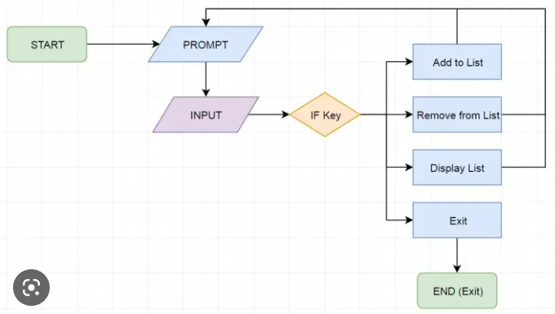
Flowchart

Slide 9
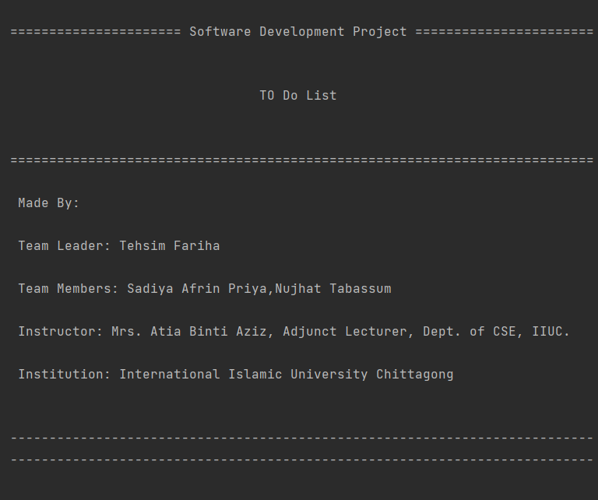
Output

Slide 10
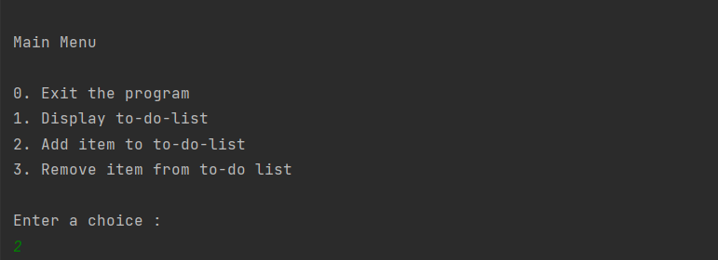

Main Menu
Add item

Slide 11
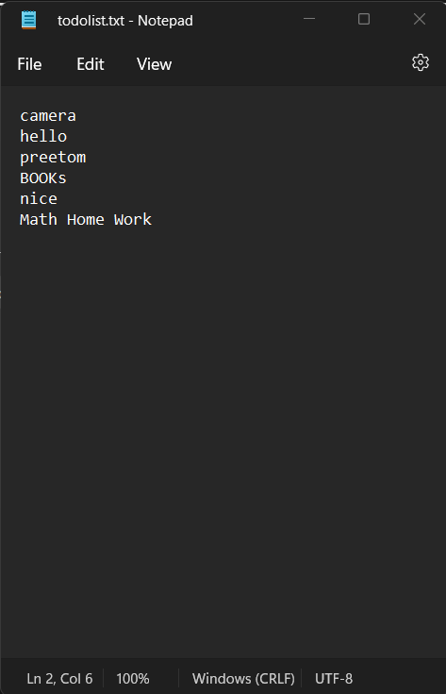
Item added in todolist.txt File

Slide 12
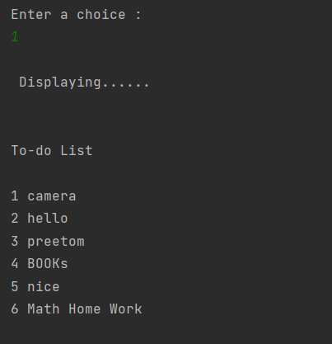
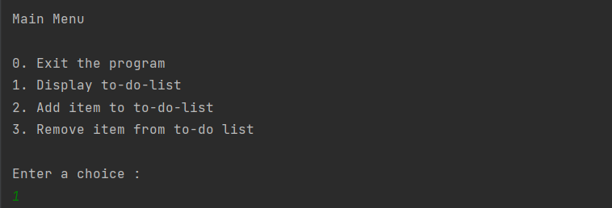
Displaying List
Choice Menu

Slide 13
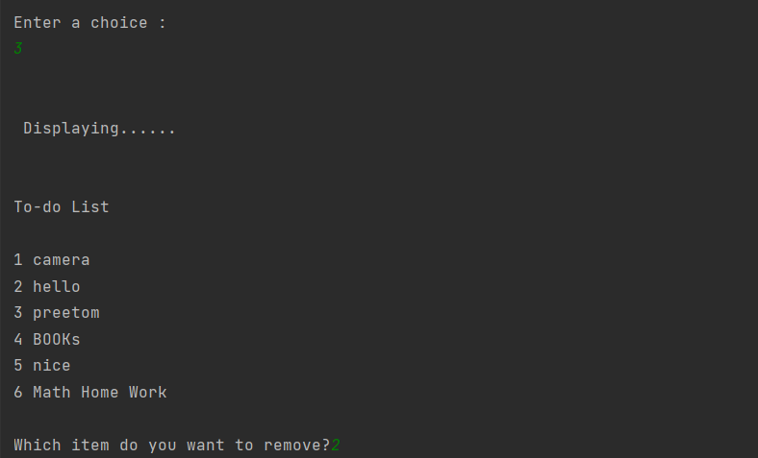
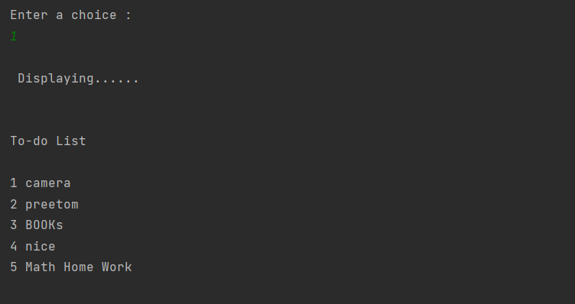
Remove item
After deleting item 2 from list

Slide 14
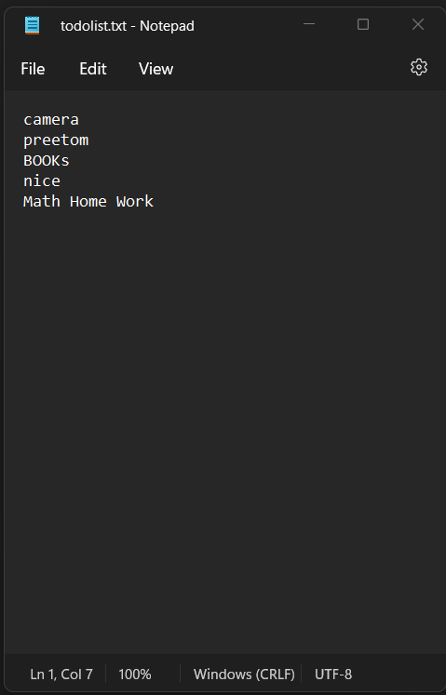
Item 2 deleted from file

Slide 15
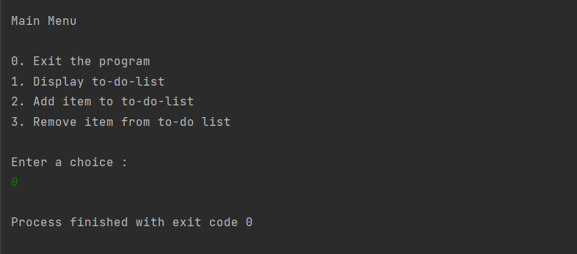
Exit the Program

Slide 16
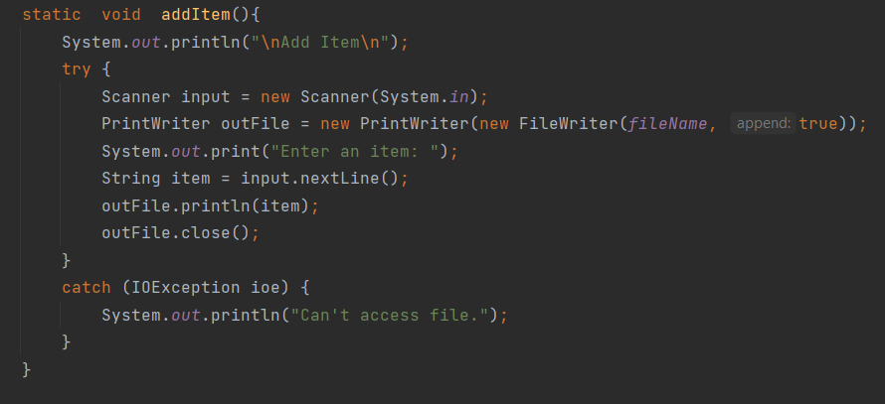
Error Handling
The exception handling in java is one of the most powerful mechanism to handle the runtime errors
So that the normal flow of the system can be maintained.
We used try-catch method for exception handling in our system.

Slide 17
Object Oriented Programming
Since Java is known as OOP language so the main aim of object-oriented programming is to implement real world entities. For example: Object, Classes, Abstraction, Inheritance, Polymorphism etc.
IN our project we have used some OOP features.
They are:
Class
Object
Inheritance

Slide 18
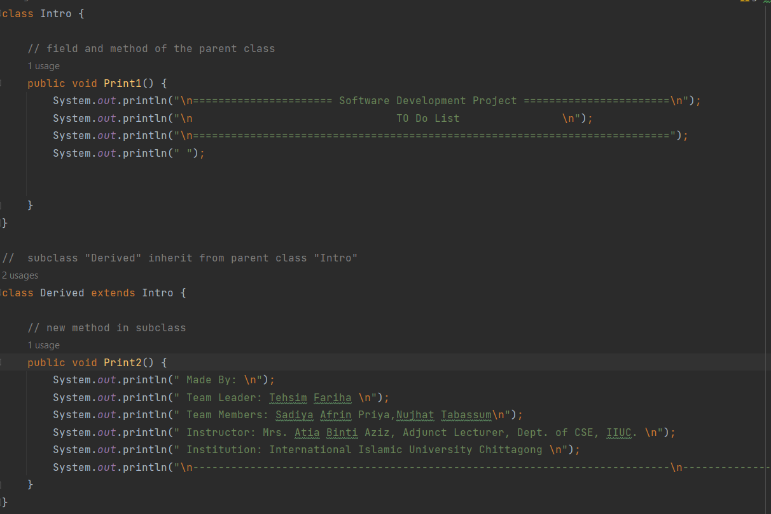
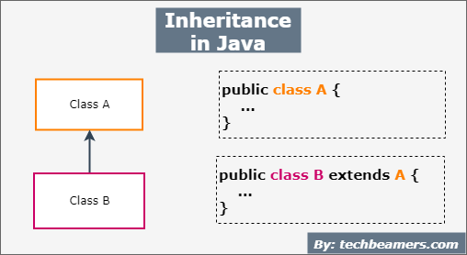
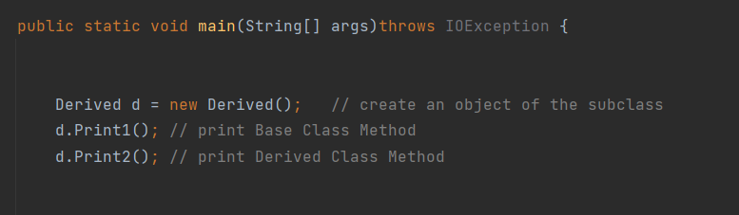
Inheritance

Slide 19
Limitation
Can’t delete the whole list at once
Don’t have search option

Slide 20
Future Scope
Application Based To-Do-List
Online Based To-Do-List
Deadlines for list items.
Review and revisit the list.
keep all list items organized.
Calendar view.

Slide 21
GitHub Link
https://github.com/Tehsim
https://github.com/sadiyaafrin4916
https://github.com/c193203nujhat

Slide 22

Thank You

